Slide 1
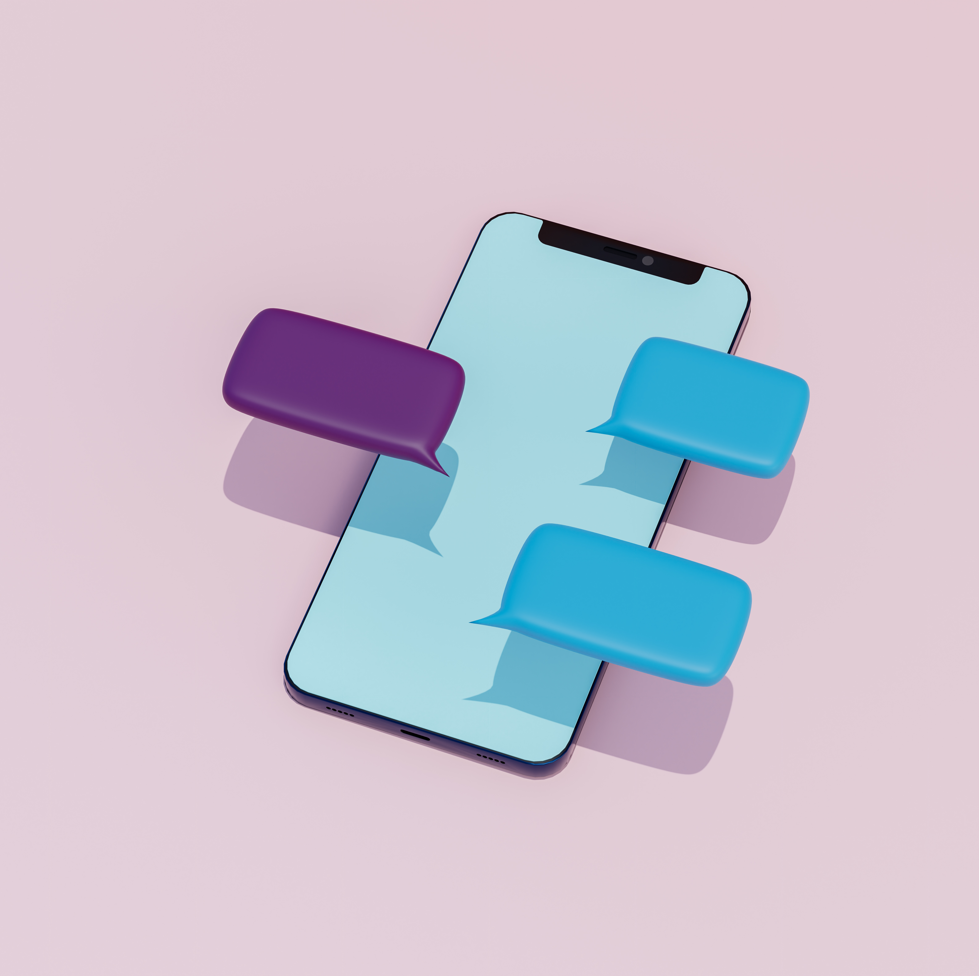
TextEvo : Chatting Redefined
Team 18
Sai Niharika Naidu Gandham
Premi Jeevarathinam
Rahul Suma Ravichandran

Slide 2
Problem Statement
We are in the era where state-of-art models are playing a huge role in the current day to day tasks after the OpenAI's chatGPT release. While we also have high speed internet and faster data rates , we can use ML in our texts to make it more meaningful and innovative.
Hence, we have come with an idea, where we can add chatGPT to any messaging app like Whatsapp or telegram.
What features can it have ?
Include ChatGPT in text chat, where a user can talk to it in the text app UI itself.
Generate image from the prompt which is done by stable diffusion currently.
Get your tone just right (Grammarly).

Slide 3
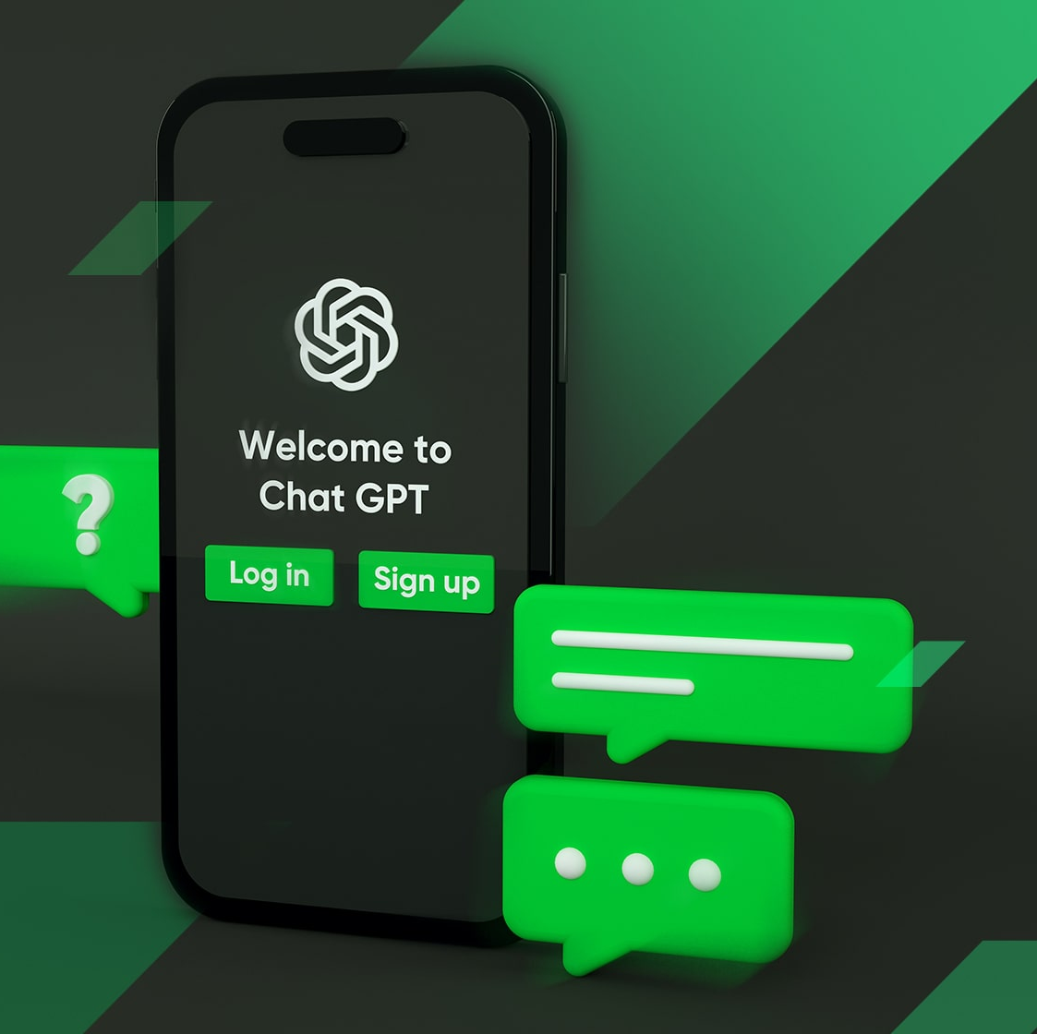
ChatGpt in a TextChat
Integrating a ChatGPT API with the text app we are using.
Interface should be designed to provide conversation window for the user and the bot.
The user posts a question in the chat window.
Get the response from the API and display in the chat windows as if the bot is replying.

Slide 4

Generate Image From Prompt
Use Text to Image API's from OpenAI/DeepAI .
Make an API call , when the response is received , depending on the form of the data , it can be downloaded or processed further to display the image.
Why ? (Something like stable diffusion)
We often use stickers from third party apps. With this, a user can generate his own image/sticker with the given prompt.

Slide 5
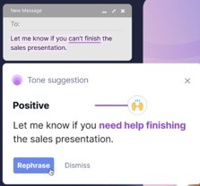
Get Your Tone Just Right
Add a "Check Tone" or similar button within the messaging interface
When the user clicks the "Check Tone" button or initiates tone analysis
Send the extracted text to the tone analysis service. This feedback could be in the form of a tone score (e.g., positive, negative, neutral), tone-related suggestions
Display the tone analysis results next to or within the message being composed
Once the user is satisfied with the tone of their message, they can proceed to send it as they normally would within the messaging application.

Slide 6

Competition Analysis
Features Comparison
Sticker/Image Generation:
Current chat apps has a vast library of stickers that users can send in chats.
However, they do not offer a feature for users to generate their own custom stickers.
Word Tuning or Sentence Tone Tuning:
They allow users to send text messages with various tones and styles, but these options are limited.
Our chat app offers a more robust tone tuning feature, allowing users to customize the tone and style of their messages more flexibly.
ChatGPT Integration:
They do not integrate an AI chatbot like ChatGPT for conversational assistance. It primarily focuses on person-to-person messaging.

Slide 7
Some users might express a desire for more advanced features, such as advanced message customization or AI-powered chat assistance.
Opportunities for Our Solution:
Our chat app can target users who seek more creative expression through sticker generation and precise message tone tuning.
User Experience and Feedback:
WhatsApp for example has a massive user base, making it a popular choice for messaging worldwide.
User feedback for WhatsApp often highlights its simplicity and reliability for basic messaging needs.
The integration of ChatGPT can attract users who value AI-powered assistance and richer conversational experiences.
Addressing any user pain points or unmet needs identified in WhatsApp's user feedback can be a key selling point for your solution.

Slide 8
Summary
While WhatsApp/Telegram are dominant players in the messaging app market, our chat app can differentiate itself by offering enhanced customization options and AI-powered chat assistance. By addressing specific user needs and preferences not fully met by current chat apps, our solution can carve out a niche and attract a unique user base.

Slide 9

Thank you

